Slide 1
Retail Data Check
By : Abhinandh O
08/10/25

Slide 2
Bussiness Context: Analyzing a Multi-Channel Retail Operation
This analysis focuses on a large retail company with a significant national footprint. The goal is to inspect and prepare its rich transactional and customer dataset to support strategic business decisions.
Business Model: The company operates a multi-channel retail strategy, engaging with customers through three primary channels: Instore, Phone Delivery, and Online sales.
Geographic Scale: It has a widespread physical presence, with hundreds of stores distributed across the North, South, East, and West regions of the country. The dataset includes customer information from 20 different states
Dataset Scope: The data provides a comprehensive, long-term view of business operations, covering over three and a half years of transactions from February 2020 to October 2023.
Core Objective: The primary objective of this inspection is to assess the quality and consistency of the company's data across key tables—including Customers, Orders, ProductsInfo, StoresInfo, OrderPayments, and OrderReviewRatings. By identifying and resolving issues, we can create a reliable foundation for accurate reporting and in-depth analysis.

Slide 3
Problem Statement
Identify and resolve integrity, consistency, and quality issues in transaction and master tables such as orders, payments, products, stores, and customers.
Detect missing or orphaned references between tables (e.g., payments recorded without matching orders), as well as duplicated and incomplete records.
Assess the impact of such anomalies on business reporting, financial reconciliation, and decision-making processes.
Audit relationships and data links across tables to highlight problematic patterns and potential causes (system errors, manual entry issues).

Slide 4
Data Dictionary (1/2)
Table Name | Primary key & foreign keys | Unique columns | Relationship | Description
Customers | Pk : Custid | customer_city, customer_state, Gender | One to many (Orders, on [Custid]) | Data about the customers location and gender. Each customer have a unique customer id
Orders | Pk : Customerid, orderid, productid Fk : Storeid | Channel, Bill_date_timestamp, Quantity, Cost per unit, MRP, Discount, Total Amount | Many to one ( Customers- [Custid] Productsinfo-[Productid] Storeinfo-[Storeid] Orderpaymnts-[orderid]) | The Orders table contains detailed information about customer purchase transactions.
Order payments | Pk : orderid | Payment_type, Payment_value | One to many Orders-[orderid] | The table includes details such as the payment type (e.g., credit card, UPI, voucher, etc.) and the payment value, which reflects the total amount paid for that order.
Order review ratings | Pk : orderid | Customer satisfaction score | one to one ( Orders-[orderid] ) | Table records customer rating for each order placed.

Slide 5
Data Dictionary (2/2)
Table Name | Primary key & foreign keys | Unique columns | Relationship | Description
Products info | Pk : productid | Category, product_name_length, product_description_length, product_photos_qty, product_weight_g, product_length_cm, product_height_cm, product_width_cm | One to many ( Orders-[productid] ) | The ProductsInfo table contains detailed information about each product available in the company’s catalog.
Stores info | Pk : storeid | Seller city, seller state, Region | One to many ( Orders-[Storeid] ) | Each store is uniquely identified by a StoreID and includes details such as the seller city, seller state, and the corresponding region (North, South, East, or West).

Slide 6
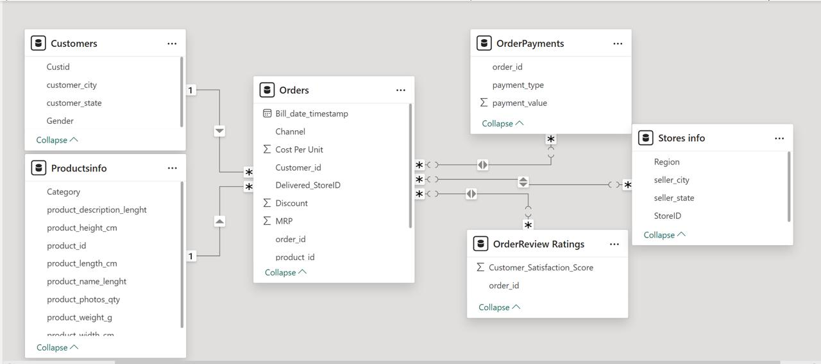
Table Relationships

Slide 7
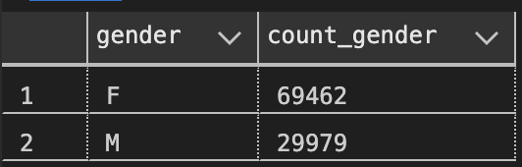
Data checks and Data Consistencies
Customers
Customers Table Inspection
No of records : 99441
Columns : Cust_id, customer_city, customer_state, Gender
Cities
Total of 4119 cities
City with most customers: Akkarampalle (15,540)
Data quality checks
No duplicates in Cust_id
No duplicate records
No null values
Insights
States
Gender distribution
Total of 20 States.
State with more customers : Andhra Pradesh (60688)
State with less customers: Goa (10)

Slide 8
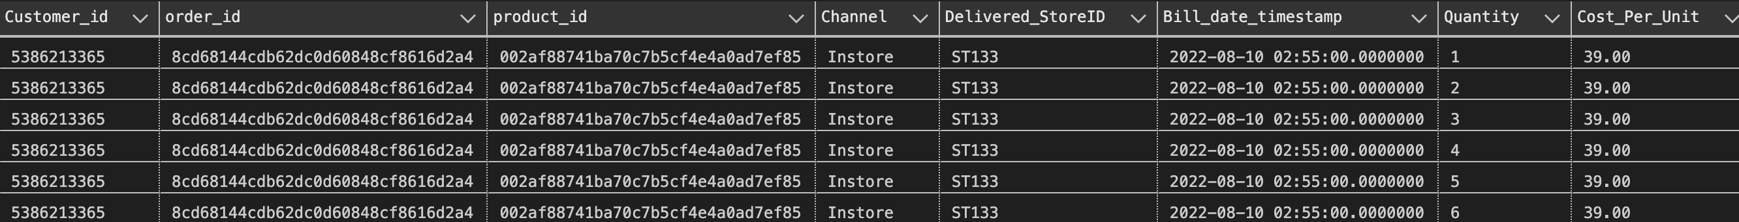
Orders Table (1/5)
Total records: 112,650
Duplicates: 7,086 rows based on composite key (order_id, product_id)
Occurrences per duplicate: 2, 3, 6, etc.
Cause: Progressive cumulative entries due to repeated transaction logs
Solution: Retain only the record with the highest quantity per order-product
Data quality:
No null values
No negative or zero entries in Quantity or Total_Amount
Billing consistency verified: Total_Amount = Quantity × (MRP - Discount) holds for all rows

Slide 9
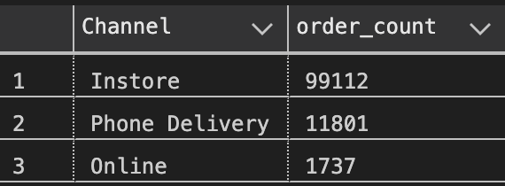
Orders Table (2/5)
Channel wise order count
Store insights:
Total of 37 stores
Highest order count: ST103 → 28,893 orders
Lowest order count: ST354 → 760 orders
Date Format Issue
Bill_date_timestamp column:
Contains inconsistent date formats (dd/mm/yyyy vs mm/dd/yyyy)
Some values stored as text strings instead of valid DATETIME
May cause issues in time-based analysis or aggregation
Recommendation: Standardize all entries to proper DATETIME format
Order timeline: Data includes orders from Feb 2020 through Oct 2023, representing over three and a half years of transactions

Slide 10
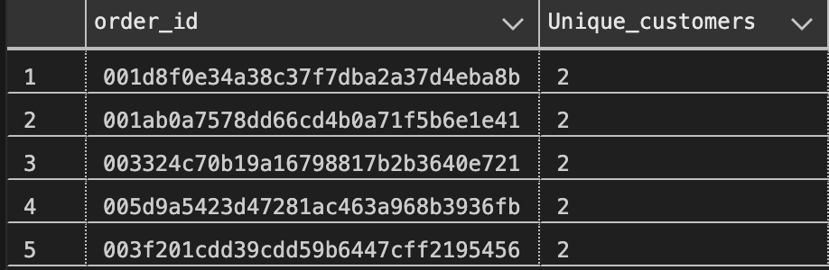
Orders Table (3/5)
Identified 5 order IDs that are linked to two different customer IDs each.
Each order_id should belong to only one customer, but duplicates were found in the mapping between
order_id and customer_id.
Why This Is a Problem:
Violates data integrity and referential consistency between Orders and Customers tables.
Can cause duplicate order counts, inflated revenue, and incorrect customer analytics.
Indicates potential issues in data entry or ETL logic during data migration or integration.
💡 What is Foreign Key Enforcement
A foreign key constraint is a rule in a database that ensures every value in a child table must exist in the parent table
Recommended Actions:
Investigate the data source or ETL process to identify how multiple customers were assigned to the same order
Enforce foreign key constraints between Orders.CUSTOMER_KEY and Customers.CUSTOMER_KEY
to maintain one-to-one order–customer relationships.
Apply data validation rules in the ETL pipeline to prevent future duplicates.
Audit and clean the existing dataset by resolving or removing duplicate order–customer links.

Slide 11
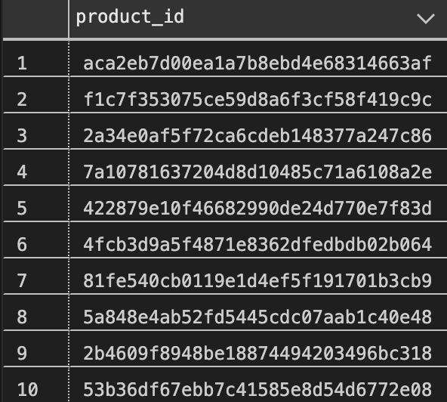
Orders Table (4/5)
Pricing Data Issue – Cost Equals MRP
Found 10 distinct Product IDs sold where Cost_Per_Unit = MRP.
These products appear in 383 orders, covering 339 distinct Order IDs.
Why This Is a Problem:
Indicates zero profit margin — unlikely in real business scenarios.
Suggests data entry or pricing logic errors during product setup or ETL.
Leads to inaccurate profit, revenue, and discount analysis.
Recommended Actions:
Verify pricing data for the affected 10 products in the product master source.
Validate business logic to ensure MRP > Cost_Per_Unit before data upload.
Add data quality checks in the ETL pipeline to flag same-cost-and-MRP cases.
Engage with pricing or finance teams to confirm if any zero-margin cases are intentional.

Slide 12
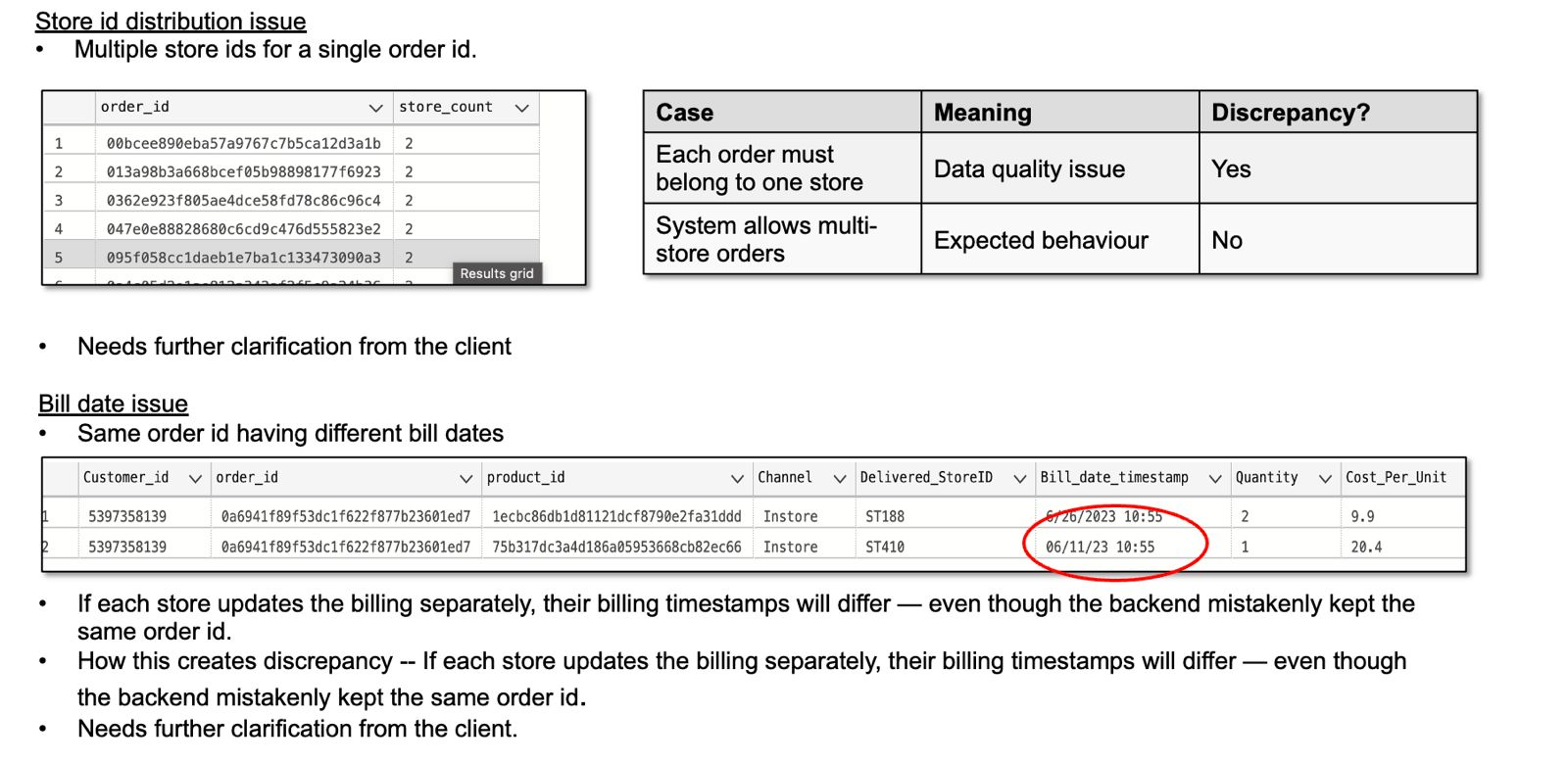
Orders Table (5/5)

Slide 13
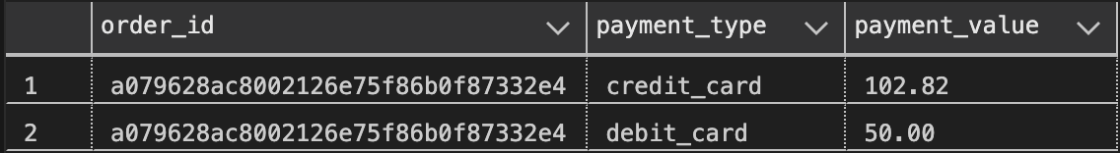
Order_payment Table
Total records: 103,886
Unique order_id: 99,440
Duplicate records: 615 rows across 308 order_ids
Payment types:
Some orders have multiple payment methods
Voucher + Credit Card: 2,245 orders
Credit + Debit Card: exists for a single order
No other combinations observed (e.g., UPI + Voucher, Debit + Voucher)
Data quality:
No null or missing values
9 entries with zero or negative payment_value

Slide 14
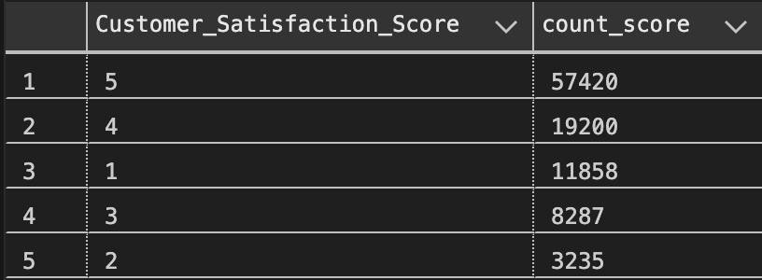
Order Review Rating Table
Total records: 100,000
Duplicates: 555 order_ids, each appearing twice
Solution: Delete 1 duplicate row per order_id to keep unique records
Null values: None — all ratings present
Distribution of Scores
Average Score - 4

Slide 15
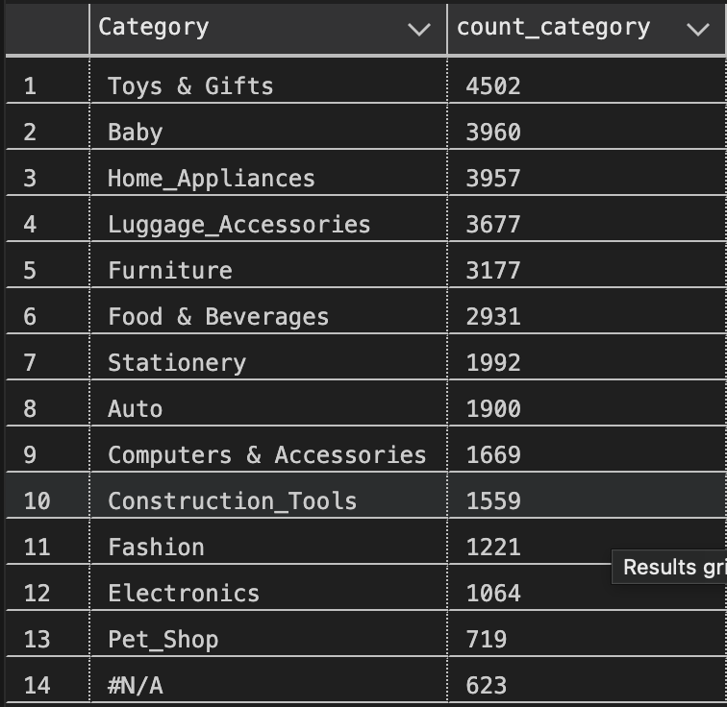
Product info Table
Product Catogory Distribution
Total records: 32,951
Duplicates: None — all product_ids are unique
Categories:
13 valid categories
623 products have Category = '#N/A' → likely
missing data during product upload,
new or unorganized products
Null / Missing Values:
Out of 623 #N/A products:
610 have nulls in product_name_length,
product_description_length, product_photos_qty
Remaining 13 products have valid values
product_weight_g, 2 NULL
product_height_cm, 2 NULL
product_width_cm: 2 NULL

Slide 16
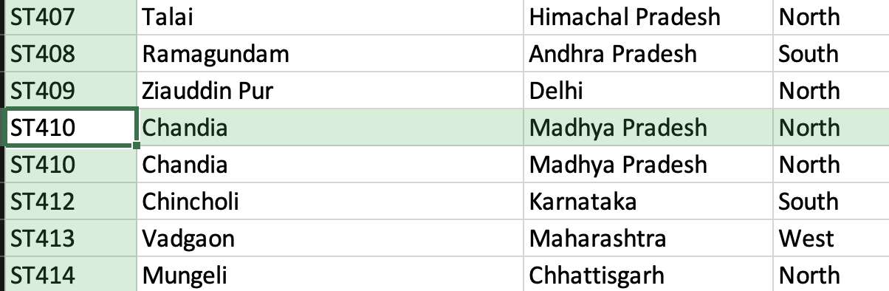
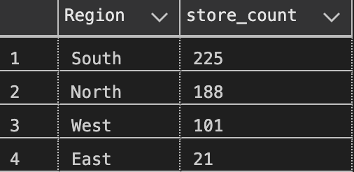
Store Info Table
Total records: 535
Duplicate store IDs: ST410 occurs 2 times, ST411 missing
Null values: None
Geography:
Total cities: 534
Total states: 19
Most stores: Andhra Pradesh → 126 stores
Least stores: Uttaranchal → 1 store
RegionWise Store Count

Slide 17
Customer Table Joining Activity — Referential Integrity Check
“Joining customer table with orders_cleaned table confirms perfect referential integrity.”
Join Type: LEFT JOIN (orders_cleaned → customer).
Result: 0 unmatched Customer_IDs.
Conclusion: Referential integrity is intact — all orders have corresponding customer records.
Stores Table — Referential Integrity Check
Join Type: LEFT JOIN (orders_cleaned → stores).
Result: 0 unmatched Store_IDs.
Conclusion: Referential integrity is intact — all orders are associated with valid stores.
Product_Info Table — Referential Integrity Check
Join Type: LEFT JOIN (orders_cleaned → product_info).
Result: 0 unmatched Product_IDs.
Conclusion: Referential integrity is intact — all orders are linked to valid products.

Slide 18
Orders_Rating Table — Missing Order_IDs Analysis
“778 order_id entries in orders_rating table have no matching records in the orders table.”
Observation: 778 records in orders_rating do not exist in the orders table.
Possible Reasons:
Data entry or import errors.
Deleted or cancelled orders.
Incorrect order_id mapping.
Impact: These unmatched ratings cannot be linked to real orders, affecting data accuracy.
Order_Payment Table — Missing Order_IDs Analysis
“830 payment records have no matching order_id in the orders_cleaned table.”
Observation: 830 payment records cannot be linked to valid orders.
Possible Causes:
Deleted or failed orders leaving payment traces.
Data migration issues.
Payments imported before order creation.
Manual data entry or API mismatches between payment and order systems.
Impact: Unlinked payments can cause financial reporting discrepancies and reconciliation errors.

Slide 19
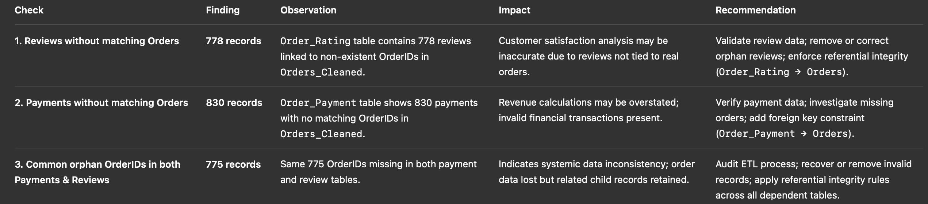
Common Observation — Orphan Order_IDs
“A total of 775 orphan order_ids are common between order_payment and order_rating tables, with no corresponding entries in orders_cleaned.”
Recommendation :
“Investigate the 775 missing order_id records to determine their origin, enforce foreign key constraints between dependent tables, and enhance ETL validation logic to ensure that dependent tables cannot reference non‑existent orders.”

Slide 20
Data Cleaning Activities
Reviewed all tables for missing, duplicate, and inconsistent records.
Checked for data type mismatches (e.g., numeric fields stored as text).
Validated foreign key relationships between fact and dimension tables.
Verified that date/time formats were consistent across datasets.
Store Table Cleaning
Identified a duplicate record for StoreID: ST410 in the Stores Info table.
Verified both entries for consistency — data was identical.
Action Taken: Dropped the duplicate record to maintain data integrity.
Product Info Table Cleaning
Identified 14 product categories in total.
One category was incorrectly labeled as “#N/A.”
Action Taken: Renamed “#N/A” category to “Others” for clarity and consistency.

Slide 21
Order Review Ratings Table Cleaning
The table initially had 100,000 rows.
Detected 555 duplicate order_id entries with different ratings.
Action Taken: Combined duplicates by taking the average Customer Satisfaction Score for each order.
Final cleaned table contains 99,441 rows.
Order Payment Table Cleaning
Identified orders with split payments across multiple method
(e.g., part via Voucher, remaining via Credit Card, UPI/Cash, or Debit Card).
To consolidate payment data, transformed the table using a PIVOT operation.
Converted payment types from rows to columns and aggregated values by order_id.
Created a new table order_payment_pivot with separate columns for each payment method
and a calculated total payment amount per order.
Final cleaned table contains 99,440 total records.

Slide 22
Orders Table Cleaning
The table initially contained 112,650 records.
Duplicates occurred due to progressive cumulative transaction logs.
Action Taken: Retained only the record with the highest quantity for each order–product pair.
Identified records with bill_date outside the valid range (2021-09-01 to 2023-10-31).
Found 3 invalid entries with duplicate bill_date and bill_time.
Action Taken: Removed 3 rows falling outside the specified billing period.
Found 911 order_id records with multiple store_id values under channel = ‘In-Store’.
Detected 334 order_id entries with multiple bill_date values.
Action Taken: Removed all such duplicate and inconsistent records.
Final cleaned table retained 101,241 valid records.

Slide 23
1.Record Count Validation
Orders_Cleaned Table: 101,239 total rows
Unique Orders (order_id): 98,663
Extra rows represent multi-product orders — each order_id can have multiple product_id entries.
Confirms that orders_cleaned is a line-level fact table.
2. Cross-Table Consistency
Order Review: 99,441 records
Order Payment Pivot: 99,440 records
Customers: 99,441 records
Record counts align at order-level, ensuring consistent joins across tables.
Only 1 unmatched order_id found between Orders and Payments — verified as acceptable.
3. Data Integrity Confirmation
All foreign key relationships validated (customer_id, product_id, store_id).
No orphan records found in key joins.
Product and Store tables act as dimension lookups, so differing record counts are expected.
Dataset is now clean, consistent, and analysis-ready.

Slide 24
Data Mismatch Summary — Orders vs Payments
Objective:
To validate data consistency between orders_cleaned and order_payment tables at the order level.
Findings:
Total Orders Compared: 101,239
Matching Records: 95,206 (94.0% consistency)
Mismatched Records: 6,033 (6.0% discrepancy)
Nature of Mismatches:
Amount Variations — Differences between total_amount (orders) and payment_total (payments) for the same order_id.
Impact:
May affect financial reporting accuracy and revenue reconciliation.
Requires validation against source transaction logs to ensure integrity of payment records.
Action Taken
Identified 5,297 mismatched records using total amount comparison logic.
Created a new audit table orders_payment_mismatch_audit to store all mismatched entries for reference and traceability.
Each record includes complete order details, order vs payment totals, variance amount, and backup timestamp.
Deleted mismatched records from orders_cleaned using the same validation condition to retain only consistent entries.
Finalized orders_cleaned with Matching Records: 95,206 (94.0% consistency) for further analysis.

Slide 25
Key Result Areas (KRA)
Ensured data integrity and consistency across customer, orders, products, stores, payments, and rating tables.
Achieved referential integrity of 100% between fact and dimension tables after data cleaning.
Implemented duplicate and null value resolution in all major tables (Orders, Payments, Ratings, Products, Stores).
Standardized data types and formats (especially bill_date_timestamp) for uniform analysis.
Created audit and mismatch tracking tables (e.g., orders_payment_mismatch_audit) for traceability.
Delivered Customer360, Order360, and Store360 analytical datasets with validated KPIs for business insights.
Supported data readiness for dashboard automation and business decision-making.
Key Risk Indicators (KRI)
Duplicate order entries causing inflated sales and customer metrics → resolved 7,086 duplicate records.
Orphan records between payments/ratings and orders → detected and documented 1,600+ mismatched records.
Pricing anomalies (Cost = MRP) indicating zero profit → flagged 10 affected product IDs.
Foreign key violations (same order linked to multiple customers) → identified and corrected mapping issues.
Date format inconsistencies in billing timestamps that could distort time-based KPIs → standardized to DATETIME.
Loss-making orders and negative payment values tracked via profit flags and validation rules.
ETL or manual entry risks leading to future data corruption → recommended enforcement of validation logic and constraints.

Slide 26
Descriptive Analysis (What Happened?)
Summarized key statistics across all core tables (Orders, Payments, Ratings, Products, Stores, Customers).
Quantified business performance metrics such as:
Total Orders: 112,650 → 101,239 (after cleaning)
Total Customers: 99,441 across 20 states and 4,119 cities
Average Customer Rating: 4 / 5
Identified top-performing segments:
Top Store: ST103 with 28,893 orders
Top State: Andhra Pradesh with 60,688 customers
Most Common Channel: Online
Created frequency and distribution visualizations for order count, profit margin, channel, and rating.
Established baseline KPIs for later dashboard development (Customer360, Order360, Store360).
Diagnostic Analysis (Why It Happened?)
Investigated anomalies and inconsistencies in the data to understand root causes of errors or trends.
Duplicate Orders: Found due to repeated transaction logs — retained only the highest-quantity record.
Payment Mismatches: 6% discrepancy traced to total amount and payment value.
Zero-Profit Products: Identified pricing setup errors where Cost = MRP for 10 products.
Orphan Records: Detected 1,600+ unlinked payments and ratings caused by ETL or manual data sync issues.
Multiple Customers per Order: Found 5 duplicate order_id mappings, violating referential integrity — resolved through source audit.
Date Format Errors: Mixed date formats leading to inconsistent time-series analysis — standardized to DATETIME.

Slide 27
Customer360 Aggregated Insights Summary
Constructed a comprehensive Customer360 view by integrating order transactions,
payments, store details, product categories, and customer satisfaction scores.
Captured key customer demographics including City, State, and Gender to enable geographic and gender-based segmentation.
Measured customer tenure using transaction dates to identify loyalty via the span between first and last purchase,
along with recent inactivity periods.
Quantified purchase behavior:
Frequency of orders (number of distinct orders per customer).
Monetary contribution (total revenue generated by each customer).
Profitability insights through total calculated profit per customer.
Analyzed shopping diversity by counting distinct products, categories, channels, stores, and cities associated
with each customer to gauge cross-category and regional engagement.
Highlighted discount and loss transactions to pinpoint customer sensitivity to discounts and potential revenue erosion scenarios.
Explored payment behavior by classifying the number and type of payment transactions (Credit Card, Debit Card, Voucher,
UPI/Cash) used by customers, including identifying the preferred payment method per customer based on transaction volume.
Aggregated customer experience metrics through the average customer satisfaction rating, providing a quality
measure for service assessment.

Slide 28
Order360 Aggregated Insights Summary
Developed an Order360 dataset by consolidating order-level details, including customer, product, store,
and transaction time information.
Quantified order content by counting distinct items, total quantity, and product categories per order for inventory insights.
Calculated financial metrics such as total order amount, total discount, cost, and profit to monitor order-level profitability.
Flagged orders with loss-making status and those yielding high profit, enabling financial risk assessment.
Identified orders occurring on weekends and classified orders into time segments (morning, afternoon, evening)
to understand purchase timing trends.
Included channel and store identifiers along with seller location to link order performance with sales points.
Averaged customer satisfaction scores at the order level to assess immediate post-purchase experience.

Slide 29
Store360 Aggregated Insights Summary
Created a comprehensive Store360 dataset by aggregating enriched order data at the store level,
incorporating sales, product, location, payment, and customer satisfaction details.
Captured store demographics including City and State to enable geographic performance analysis.
Summarized order content and sales metrics, including the number of distinct products, total quantity sold, total sales,
total discount given, and total cost and profit generated by each store.
Flagged loss-making stores by aggregating orders with negative profit and identified stores with a significant number
of high-profit orders for targeted business strategies.
Analyzed transaction timing by counting sales on weekends versus weekdays and during different time-of-day slots
(morning, afternoon, evening, night) to optimize store operations and marketing campaigns.
Calculated performance ratios such as average order value, average profit per transaction, average profit per customer,
and average customer visits per store to benchmark store efficiency.
Measured customer experience via average customer satisfaction ratings aggregated at the store level.

Slide 30
Customer 360 Dashboard Layout
To provide a unified view of each customer’s engagement, spending behavior, and satisfaction,
enabling insights into retention, profitability, and purchase patterns.
Key KPIs
Total Customers – COUNT(Customer_ID)
Total Revenue (Monetary) – SUM(Total_Amount)
Average Profit per Customer – SUM(Total_Profit) / COUNT(Customer_ID)
Average Customer Rating – AVG(Avg_Customer_Rating)
Average Tenure (Days) – AVG(Tenure_Days)
Distinct Payment Methods Used – COUNT(DISTINCT Payment_Types)
Total Quantity Purchased – SUM(Total_Quantity)
Transactions with Discount / Loss – SUM(Transactions_With_Discount) / SUM(Transactions_With_Loss)
---------------------------------------------------------------------
| CUSTOMER 360 DASHBOARD (Title) | Filters: Date Range | State | Gender |
---------------------------------------------------------------------
| [Total Customers] | [Total Revenue] | [Avg Profit/Customer] | [Avg Rating] |
---------------------------------------------------------------------
| [Chart 1] Customer Frequency vs Monetary Value (Scatter Plot) |
| [Chart 2] Top 10 Cities by Active Customers (Horizontal Bar) |
---------------------------------------------------------------------
| [Chart 3] Preferred Payment Method Distribution (Pie Chart) |
| [Chart 4] Active vs Inactive Customers (Donut Chart) |
---------------------------------------------------------------------
| [Chart 5] Discount Impact on Profitability (Line Chart) |
---------------------------------------------------------------------
Filter Options
Date Range
Customer State / City
Gender
Channel (Online / In-Store)

Slide 31
Order 360 Dashboard Layout
To monitor order-level performance, profitability, and time/channel trends for business optimization and operational analysis.
Key KPIs
Total Orders – COUNT(Order_ID)
Total Sales Value – SUM(Total_Amount)
Average Order Value (AOV) – SUM(Total_Amount)/COUNT(Order_ID)
Total Profit – SUM(Total_Profit)
% Loss-Making Orders – COUNT(Flag_Loss_Making=1)/COUNT(Order_ID)
Time of Day Distribution – (Morning / Afternoon / Evening / Night)
Weekend vs Weekday Transactions – Derived from Bill_date_timestamp
Average Customer Rating – AVG(Avg_Customer_Rating)
---------------------------------------------------------------------
| ORDER 360 DASHBOARD (Title) | Filters: Date | Channel | Store | City |
---------------------------------------------------------------------
| [Total Orders] | [Total Sales] | [Avg Order Value] | [Avg Rating] |
---------------------------------------------------------------------
| [Chart 1] Sales & Profit by Channel (Clustered Column Chart) |
| [Chart 2] Orders by Time of Day (Bar: Morning/Afternoon/Evening) |
---------------------------------------------------------------------
| [Chart 3] Weekend vs Weekday Orders (Stacked Column) |
| [Chart 4] High vs Low Profit Order Split (Pie Chart) |
---------------------------------------------------------------------
| [Chart 5] Orders by State or City (Filled Map or Tree Map) |
---------------------------------------------------------------------
Filter Options
Date Range
Channel
Store
City / State

Slide 32
Store 360 Dashboard Layout
To evaluate store-level sales, profitability, and performance metrics across geography and time, highlighting top
and low-performing stores.
Key KPIs
Total Stores – COUNT(Store_ID)
Total Store Sales – SUM(Total_Sales)
Average Profit per Store – SUM(Total_Profit)/COUNT(Store_ID)
Average Order Value – SUM(Total_Sales)/Orders
Average Customer Rating – AVG(Avg_Customer_Rating)
Orders with High Profit – SUM(Orders_With_High_Profit)
Loss-Making Stores – COUNT(Flag_Loss_Making=1)
Transactions by Time of Day – (Morning/Afternoon/Evening/Night)
Weekend vs Weekday Transactions – DATENAME(WEEKDAY, Bill_date_timestamp)
---------------------------------------------------------------------
| STORE 360 DASHBOARD (Title) | Filters: State | City | Date Range |
---------------------------------------------------------------------
| [Total Stores] | [Total Sales] | [Avg Profit/Store] | [Avg Rating] |
---------------------------------------------------------------------
| [Chart 1] Sales vs Profit by Store (Clustered Bar Chart) |
| [Chart 2] Average Order Value by Store (Column Chart) |
---------------------------------------------------------------------
| [Chart 3] Transaction Count by Time of Day (Stacked Bar) |
| [Chart 4] Weekend vs Weekday Orders (Column Chart) |
---------------------------------------------------------------------
| [Chart 5] Profit per Customer vs Satisfaction (Scatter Plot) |
| [Chart 6] Top 5 Performing Stores (Map Visualization) |
---------------------------------------------------------------------
Filter Options
State
City
Date Range
Category / Channel

Slide 33
Tools Overview
Phase | Tool Used | Purpose / Activity
Data Viewing & Understanding | Microsoft Excel | - Initial data exploration and familiarization- Viewing datasets, verifying column structures, identifying nulls and outliers
Data Cleaning & Transformation | SQL (Microsoft SQL Server ) | - Removing duplicates and invalid entries- Validating data consistency (foreign keys, date ranges, mismatched records)- Creating cleaned and enriched tables (Customer_360, Order_360, Store_360)
Visualization & Dashboard Planning | Power BI (Planned) | - Dashboard creation for Customer360, Order360, and Store360 views- KPI visualization, interactivity, and data storytelling
Presentation & Documentation | Microsoft PowerPoint | - Structuring findings, methods, and dashboard layout designs- Presenting final deliverables and insights clearly
Optional Support Tool | Excel + SQL Integration | - Cross-validation of record counts and sample data checks

Slide 34
“ Retail Performance Overview (2021–2023)”
Overall metrics | Values
Total Revenue | 15.03 million
Total Profit | 2.62 million
Profit Margin | 17.45%
Total Customers | 95117
Total Stores | 37
Total States | 7
Total Orders | 95206
Average discount percentage | 3.17
Average Customer Rating | 4
Average Customer Spending | 158.03
Average Transaction per customer | 1
Most Revenue Year | 2023 (8.32 million.)
The business achieved ₹15.03M in total sales, generating a 17.45% overall profit margin
— indicating strong operational efficiency.
2023 was the best-performing year, contributing over 55% of total revenue,
showing consistent year-over-year growth.
The chain successfully served over 95K customers through 37 stores, in 7 states
reflecting broad geographic coverage and a stable customer base.
With 95K+ orders, the average spending per customer (₹158) highlights moderate
but widespread purchasing behavior.
An average rating of 4.0 suggests overall positive customer satisfaction
and reliable service experience.
Since the average transactions per customer = 1, it tells us something subtle
but important: each customer, on average, only made one purchase
— meaning the business has broad reach but low repeat engagement.
“Average discount offered is just 3.17% of total sales value, indicating limited dependency
on discounts.
This reflects a strong pricing strategy where customers are willing to
purchase at near full price.”

Slide 35
Month-wise Revenue and Profit Trends (2021–2023)
2021
Only 2 months of data available (October and December).
Revenue was minimal — ₹53.8K in October and ₹19.6K in December, with total profit below ₹9K each month.
Reflects the initial phase of operations or data capture beginning late in 2021.
2022
Revenue expanded rapidly across months — starting from ₹87K in January and reaching ₹996K by December.
Highest Revenue: December 2022 (₹996K, 6.63% share of total revenue).
Lowest Revenue: January 2022 (₹87K).
Profit followed a similar upward trend — from ₹13K in January to ₹171K in December.
Revenue Share: Concentrated toward the second half of 2022 (Aug–Dec) indicating strong seasonal or festive sales.
The steady rise across months shows consistent business growth and customer expansion.
2023
Sustained high-volume performance throughout the year with strong month-over-month figures.
Top Revenue Month: August 2023 – ₹1.19M (7.95% share).
Top Profit Month: August 2023 – ₹220K profit.
Lowest Revenue Month: September 2023 – ₹148K, possibly due to limited data or short trading period.
Overall, 2023 demonstrates mature performance with stable profits, averaging ~₹1M+ revenue per month.

Slide 36
3-Year Business Performance Summary (2021–2023)
The business grew exponentially over three years — both in revenue and profit.
2021 had limited activity (only 294 customers, 0.36% of total revenue).
2022 marked the first full operational year — generating ₹6.65M revenue and ₹1.12M profit, contributing 44% of total revenue.
2023 became the best-performing year, reaching ₹8.33M revenue and ₹1.49M profit, with profit margin rising to 17.9%.
The profit margin improved from 15.1% → 16.9% → 17.9%, reflecting stronger pricing and cost efficiency.
Customer base expanded rapidly — from 294 (2021) to 52,845 (2023), showing massive customer adoption and brand reach.
Total discounts increased from ₹1.4K (2021) to ₹270K (2023) — growth consistent with higher sales volume.
2023 alone contributed 55% of total revenue and 57% of total profit, highlighting operational maturity.
Recommendations
Customer Retention: Strengthen loyalty and engagement strategies to sustain the rapidly growing base.
Revenue Optimization: Focus on high-margin categories and customer segments driving 2023’s success.
Profitability Focus: Keep discounts low (around 3%) and control costs so that profits stay steady even when sales grow.
Growth Consistency: Smooth revenue fluctuations by boosting low-performing months and stores.
Data Continuity: Ensure complete monthly data collection to enhance future forecasting accuracy.

Slide 37
Impact of Discounts on Customers and Profitability
Insights Summary:
57K customers (60%) purchased without discounts, while 38K (40%) availed discounts.
Despite fewer customers, discount shoppers contributed ~59% of total profit.
Average profit per discount customer (₹40) is over 2× higher than non-discount buyers (₹19).
Indicates discounts successfully drive profitable engagement rather than just revenue boosts.
Recommendations:
Focus discounts on high-value or repeat buyers to maximize ROI.
Monitor profit per customer regularly to avoid margin erosion.
Use seasonal or targeted offers, not blanket discounts, to sustain growth.

Slide 38
Gender-Wise Revenue and Profit Contribution
Insight:
Female customers form the majority of the customer base — 66K (70%) —
and generate nearly ₹10.5M in revenue, contributing ~70% of total profit.
Despite similar average spending (₹158 per customer) across genders,
women drive 2.3× higher total profit than men.
This suggests stronger purchase engagement and conversion among female customers,
indicating that brand affinity and retention are higher in this segment.
Recommendation:
Prioritize female-focused marketing and loyalty programs, as they are the
primary revenue drivers.
Introduce targeted campaigns for male customers to improve engagement and narrow
the contribution gap.
Maintain balanced product offerings but leverage female buying behavior for category
expansion and upselling opportunities.

Slide 39
Top Performing States & Cities – Customer Profitability Insights
West Bengal, Rajasthan, and Uttar Pradesh lead in average profit per customer (~₹36–37),
showing strong purchasing potential despite smaller customer bases.
Tamil Nadu and Maharashtra follow closely, contributing large total revenue due to high customer volumes.
Akkarampalle (Andhra Pradesh) is the top revenue-generating city with ₹2.04M (13.6% of total revenue).
Badepalle and Anantapur also show strong revenue concentration, forming the top 3 city clusters driving over 23% of total customer revenue.
Profit and revenue distribution indicate regional concentration — southern and eastern states dominate both reach and profitability.
Recommendations:
Strengthen marketing and product availability in high-profit states (West Bengal, Rajasthan, Uttar Pradesh).
Enhance store capacity and customer experience in leading cities like Akkarampalle and Badepalle to sustain growth.
Target mid-performing states (e.g., Kerala, Punjab, Karnataka) with loyalty programs to raise profit per customer.
Use these insights to prioritize regional campaigns and guide store expansion or digital promotions in top-performing areas.

Slide 40
Revenue & Profit by Sales Channel
Insights:
In-store channel dominates performance with 87.6% of total revenue (₹13.16M) and highest profit (₹2.30M)
— proving physical stores remain the retail chain’s main growth driver.
Phone delivery contributes 10.6% of revenue, showing steady profitability and consistent order volumes.
Online channel, though only 1.9% of revenue, shows the highest average order value (₹181.25)
— signaling strong potential for premium or high-ticket sales if scaled properly.
Recommendations:
Maintain focus on in-store operations while improving customer retention and upselling opportunities.
Expand online sales infrastructure and marketing — high order value indicates untapped digital growth.
Streamline phone delivery efficiency to maintain profitability and possibly merge it with online order systems for better scalability.

Slide 41
Time-Based Order & Revenue Patterns
Insights:
Weekdays dominate sales with 79% of total revenue (₹11.9M) — indicating steady, recurring purchases.
Weekends contribute 21% (₹3.1M), showing stronger engagement despite fewer orders — potential for event-driven boosts.
Evening hours are peak revenue drivers, contributing ~47% of total sales, reflecting customer preference for after-work or leisure shopping.
Afternoons account for 33%, while mornings contribute ~20%, suggesting limited early-day activity.
Average spend per order remains consistent (~₹158), showing stable purchase behavior across timeframes.
Recommendations:
Schedule promotions or new product launches during evenings/weekends to maximize visibility and sales
Strengthen weekday retention programs for steady income flow.
Explore morning-hour incentives (e.g., flash discounts or loyalty rewards) to balance daily order volume.

Slide 42
THANK YOU!

